Slide 1
Sanitary Engineering
Water supply Engineering
By
Dr. Muhanad M. Abbas

Slide 2
TODAY TOPICS
Forecasting population
Water consumption for various purposes
Factors Affecting consumption
Fire demand
Example

Slide 3
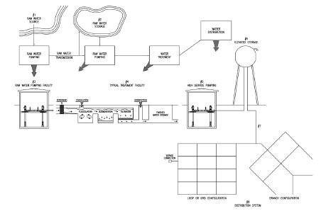
Notes:
WWTP, WTP, design requirements

Slide 4
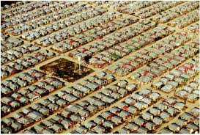

Slide 5
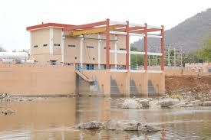
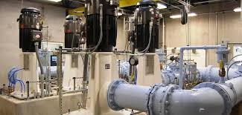
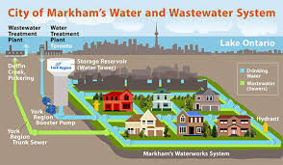
Forecasting population

Slide 6
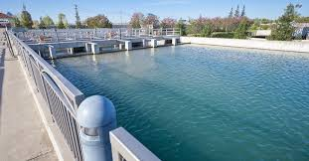
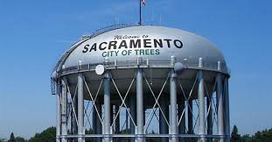
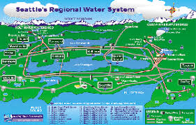

Slide 7
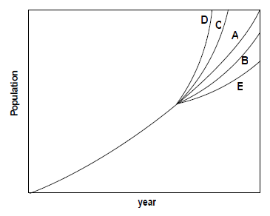

Slide 8
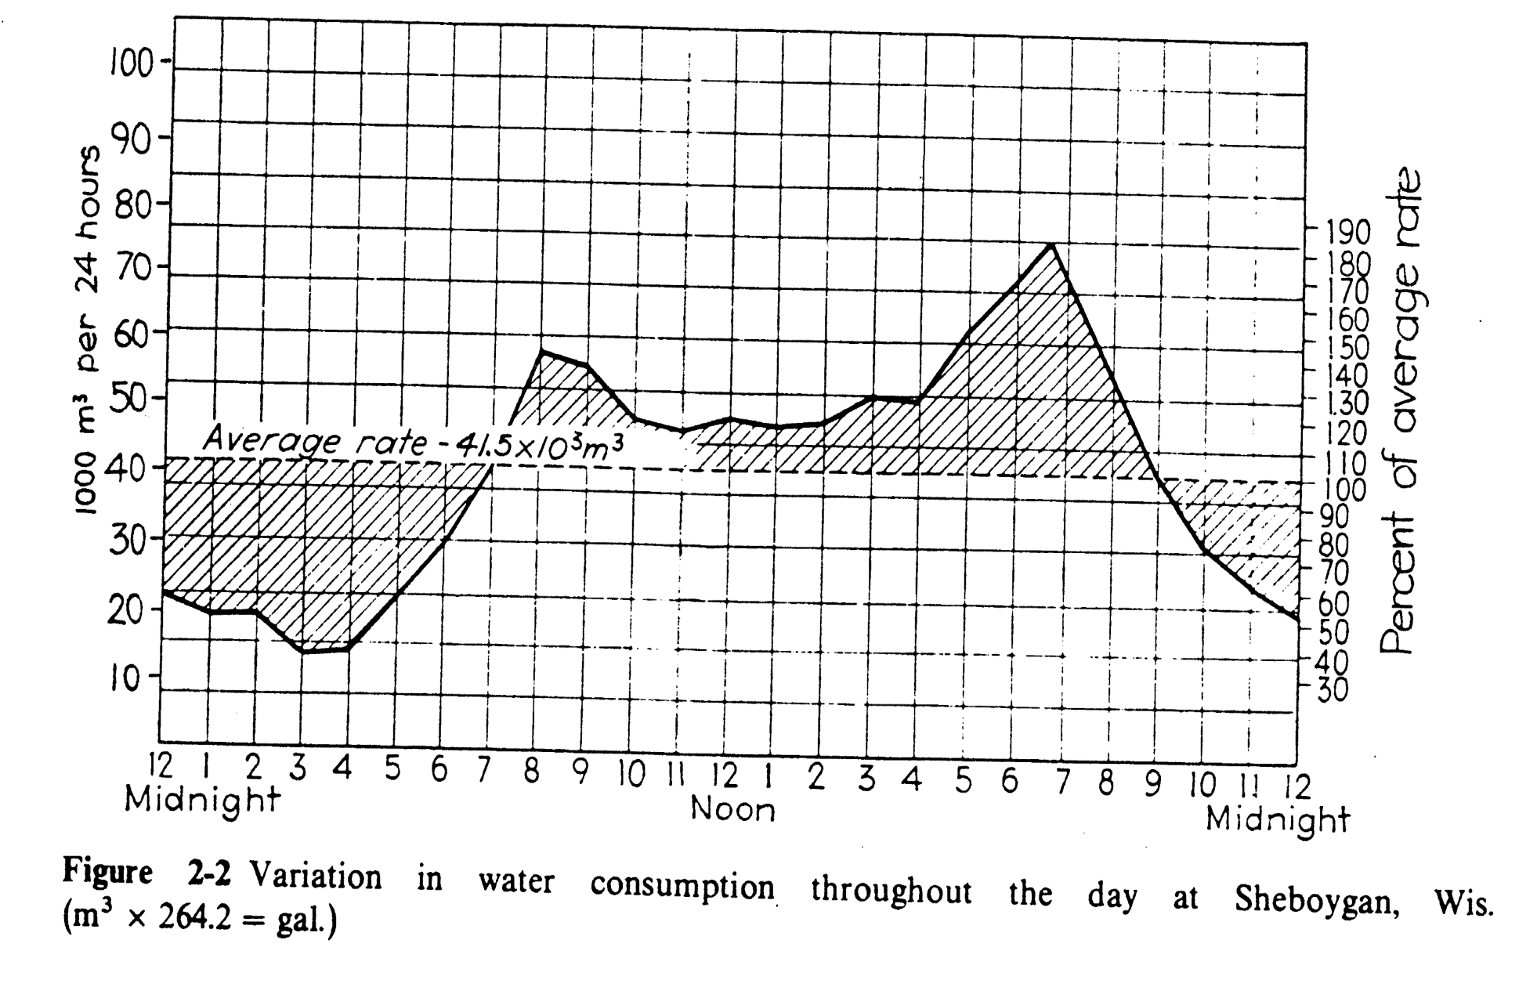

Slide 9
Example / City population 20000 cap. Consumed 100 gall./cap./d living in wood building area 2 Km2 with two stories. Find total demand with 2 hr fire.

Slide 10
